Slide 1
CONTENT
School Local Area Network
1.0 - Security and Stability
2.0 - Operation performance
prepared by Group 1:
On Wu Xu 2290113-DCS
Lim Yee Jie 2290025-DCS
Yap Kah Seng 2290146-DCS
Huai Zi Yao 2290085-DCS
3.0 - Market Compatibility
4.0 - UI Interface/User Experience
5.0 - Open source & closed source
6.0 - Application scenarios

Slide 2


School Local Area Network
CONTENT
Security and Stability
Security and Stability
1.0 - Introduction
2.0 - Floor Plan Layout
3.0 - Network Devices
4.0 - Network Design
5.0 - Conclusion
prepared by Group 1:
On Wu Xu 2290113-DCS
Lim Yee Jie 2290025-DCS
Yap Kah Seng 2290146-DCS
Huai Zi Yao 2290085-DCS
Tan Thee Wei 2290107-DCS
Lee Mun Hinn 2270771-DCS

Slide 3
CONTENT
Introduction
This project's goal is to plan and set up a Local Area Network (LAN) topology that connects the buildings, as well as to set up network devices that will be used across the facility. To demonstrate how the network connects with one another across the buildings' computer centre, classrooms, offices, and multipurpose Hall, a full floor plan of the buildings and an IP addressing system will also be created.
Notes:
https://zhuanlan.zhihu.com/p/38316760 https://linuxsecurity.com/features/how-secure-is-linux

Slide 4
Floor Plan Layout

Slide 5
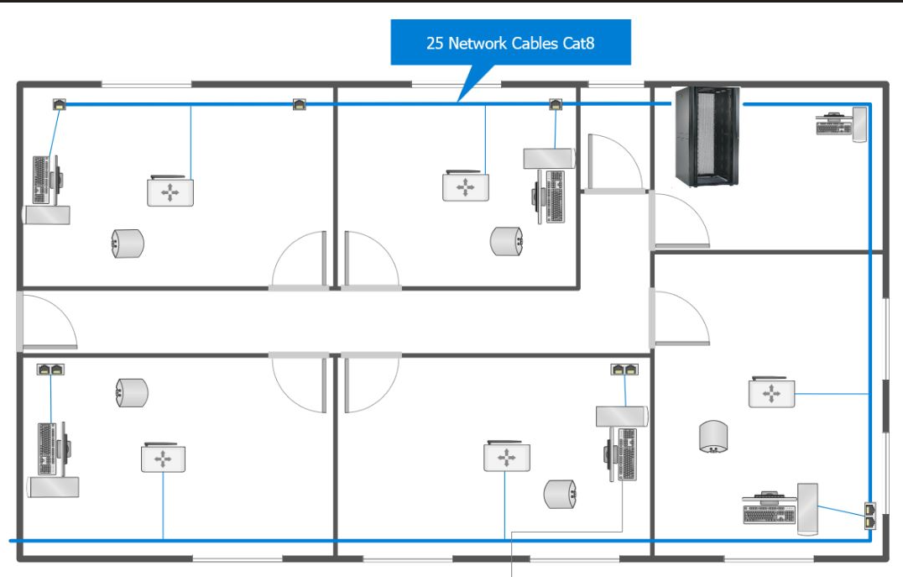
Floor 1 – Classroom
Server Room
Classroom X 5
Notes:
https://zhuanlan.zhihu.com/p/38316760 https://linuxsecurity.com/features/how-secure-is-linux

Slide 6
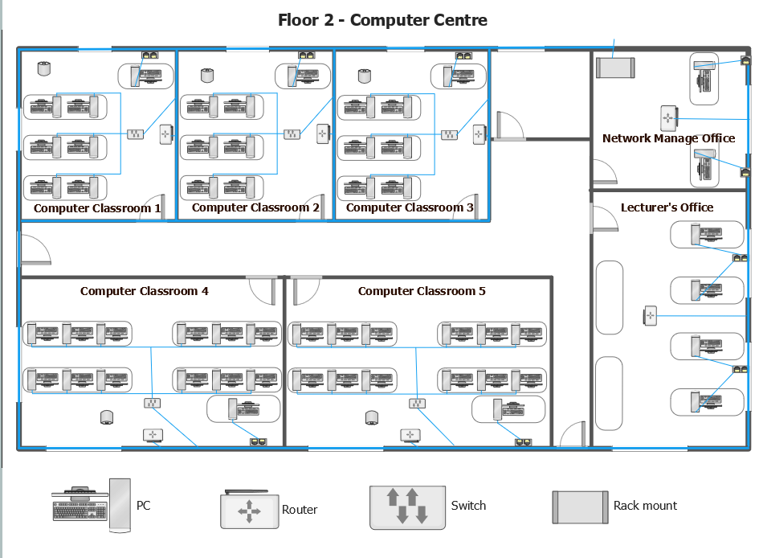
Floor 2 - Computer Centre
Computer Classroom X 5
Network Management Office
Lecturer's Office
Notes:
https://zhuanlan.zhihu.com/p/38316760 https://linuxsecurity.com/features/how-secure-is-linux

Slide 7
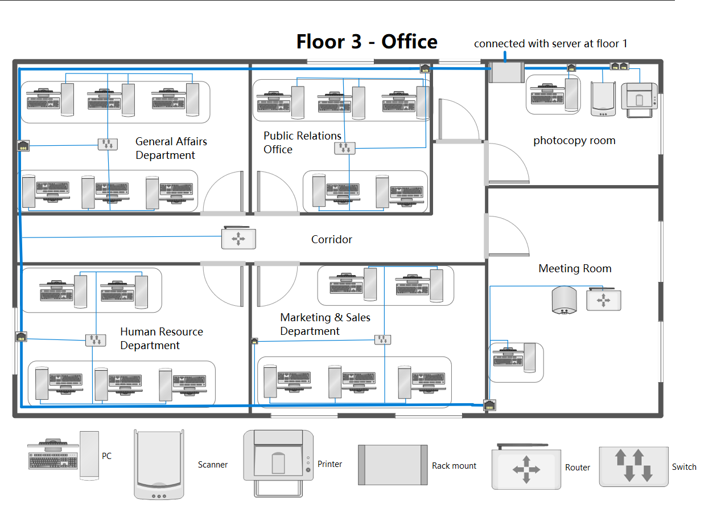
Floor 3 - Staff Office
Staff Offices X 4
Meeting Room
Photocopy Room
Notes:
https://zhuanlan.zhihu.com/p/38316760 https://linuxsecurity.com/features/how-secure-is-linux

Slide 8
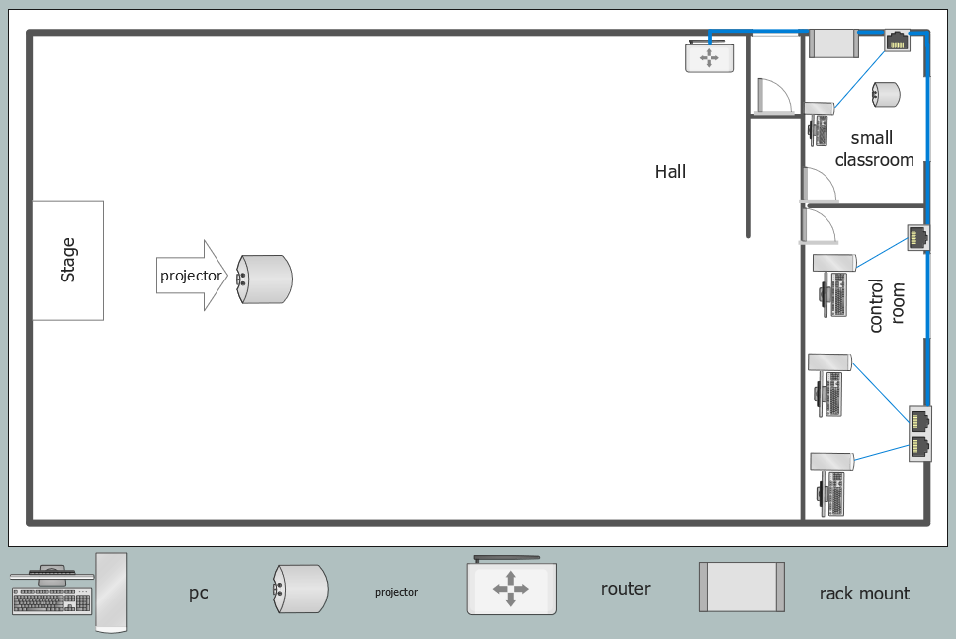
Floor 4 – Multipurpose Hall
Small classroom
Hall
Control room
Notes:
https://zhuanlan.zhihu.com/p/38316760 https://linuxsecurity.com/features/how-secure-is-linux

Slide 9
Network Devices

Slide 10
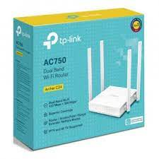
Router
Product Name | AC750
WiFi Speeds | 5 GHz: 433 Mbps 2.4 GHz: 300 Mbps
Data Transfer Rates | 750 Mbps
Range | 2 Bedroom Houses
Wireless Wired | wireless
Price | RM109
Notes:
https://zhuanlan.zhihu.com/p/38316760 https://linuxsecurity.com/features/how-secure-is-linux

Slide 11

Switch
Product Name | WS-C2960-24TT-L
Backplane Capacity | 16Gbps
Throughput | 6.5mpps
Ports Quantity | 24
Gigabit Ports | 0
Wireless Wired | wired
Price | RM931
Notes:
https://zhuanlan.zhihu.com/p/38316760 https://linuxsecurity.com/features/how-secure-is-linux

Slide 12
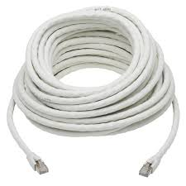
Cabling
Product Name | Cat 8
Price | RM12.69 per m
Notes:
https://zhuanlan.zhihu.com/p/38316760 https://linuxsecurity.com/features/how-secure-is-linux

Slide 13
Network Design

Slide 14
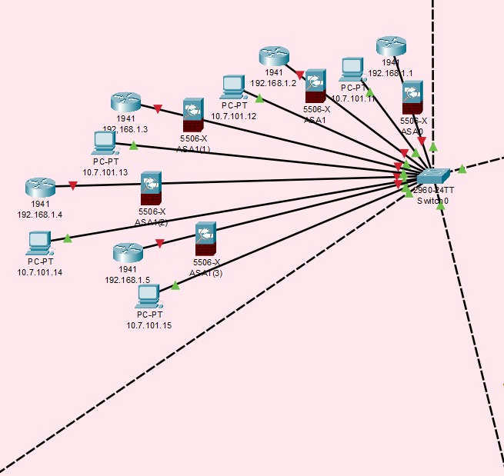
Floor 1 – Classroom
Notes:
https://zhuanlan.zhihu.com/p/38316760 https://linuxsecurity.com/features/how-secure-is-linux

Slide 15
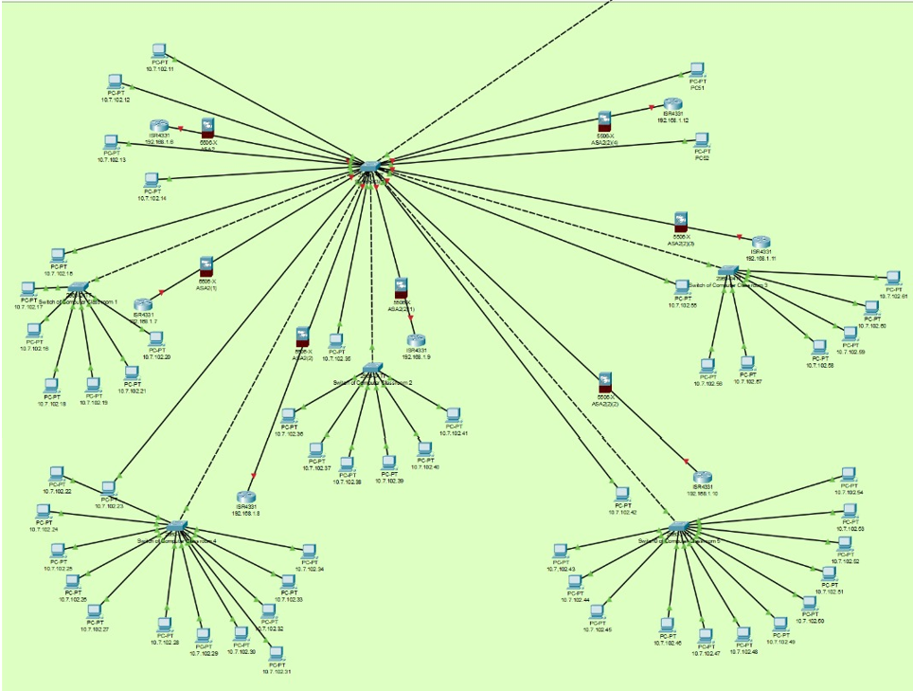
Floor 2 – Computer Centre
Notes:
https://zhuanlan.zhihu.com/p/38316760 https://linuxsecurity.com/features/how-secure-is-linux

Slide 16
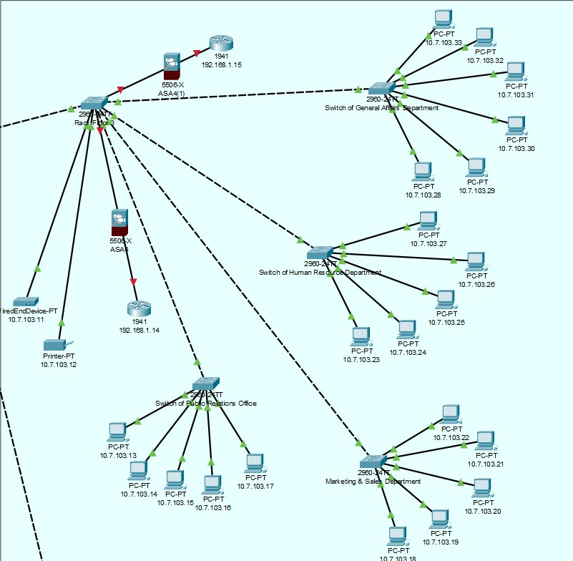
Floor 3 – Staff Office
Notes:
https://zhuanlan.zhihu.com/p/38316760 https://linuxsecurity.com/features/how-secure-is-linux

Slide 17
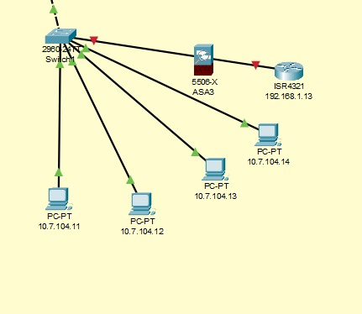
Floor 4 – Multipurpose Hall
Notes:
https://zhuanlan.zhihu.com/p/38316760 https://linuxsecurity.com/features/how-secure-is-linux

Slide 18
Conclusion
In summary, the implementation of the school network transcends conventional boundaries, fostering collaboration, innovation, and growth. It amplifies learning opportunities, enhances administrative processes, and reflects the school's dedication to cultivating a dynamic and forward-looking educational ecosystem.
Notes:
https://interworks.com/blog/2021/02/11/put-to-the-test-is-windows-or-linux-faster/

Slide 19
Thank You
Notes:
https://interworks.com/blog/2021/02/11/put-to-the-test-is-windows-or-linux-faster/

